Slide 1
Screening in vaccinated and unvaccinated women: are two algorithms necessary and if so how do we implement them?

Slide 2
CERVIVA – Who we are
CERVIVA was established in 2005
Initially funded to perform high quality research in the area of cervical screening in Ireland, with the overarching aim to support the National Cervical Screening Programme
Our research portfolio has expanded to include all HPV-associated cancers.
Three research pillars:
Molecular epidemiology
Health economics
Health psychology

Slide 3
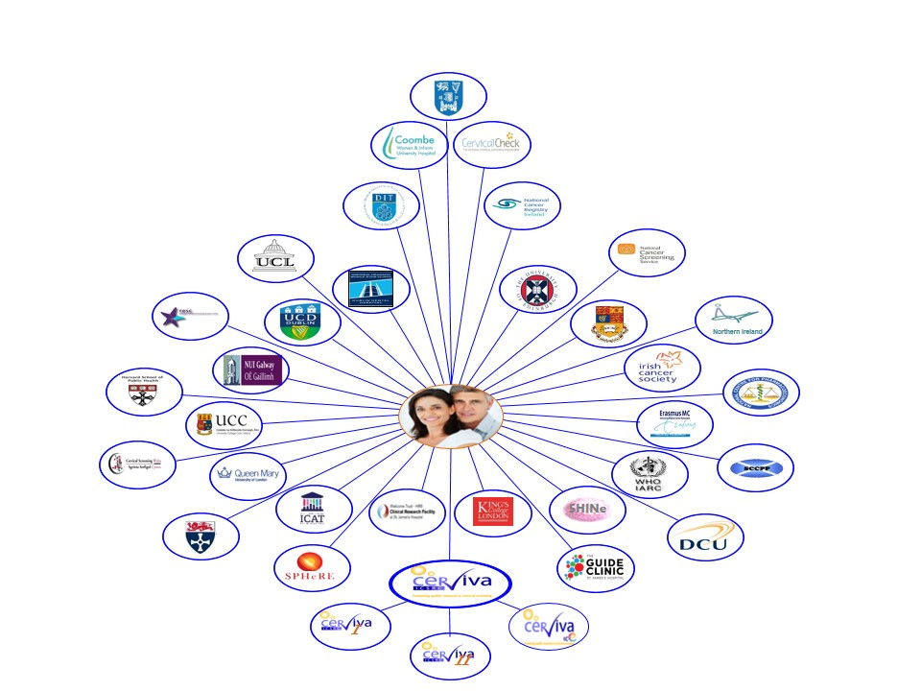
CERVIVA’s International Ecosystem

Slide 4
Outline of talk
Background
Studies from Norway, Australia, England, Ireland, The Netherlands
Findings
Strengths and limitations
Overall conclusions
Future directions/Where to target future research efforts

Slide 5
Background
Cervical cancer preventions is rapidly evolving following the adoption of HPV vaccination and HPV-based testing
Optimal cervical cancer prevention requires effective vaccination AND screening
Current HPV vaccines will not prevent all high-risk HPV infections and HPV vaccinated women will need some kind of screening in their lifetime
Vaccinated cohorts of women will soon be eligible for cervical screening
Screening programmes need to review their current screening algorithms:
-tailored screening to HPV vaccine status?
‘The elephant in the room’ - Screening in HPV vaccinated and unvaccinated women

Slide 6
What is the evidence emerging?
key first experience of screening in vaccinated populations

Slide 7
Norway
Norwegian girls vaccinated with the 4vHPV at age 12 years in 2009 will become eligible for CC screening in 2022
Mathematical modelling to identify optimal screening strategies for women vaccinated against HPV infections
Strategies considered: women vaccinated with the 2/4vHPV and 9vHPV vaccines
The value of stratified guidelines also considered
Pedersen et al. 2018 Eur J Cancer, 91: 68-75
Notes:
Different strategies looked at and different assumptions were made

Slide 8
Norway - study findings
Less intensive screening strategies are required for cervical screening to remain cost-effective in vaccinated women
For Norwegian women vaccinated with the 9vHPV or 2/ 4vHPV, the optimal strategies involved screening once or twice per lifetime using HPV testing
De-intensifying screening in women confirmed to have been fully vaccinated against HPV in adolescence can result in efficiency gains
Stratified screening (by HPV vaccination status) is important for screening to balance benefits, harms and resource use
A considerable amount could be spent towards implementing separate CC screening guidelines according to individual HPV vaccination status

Slide 9
Norway study - limitations
Did not evaluate optimal screening among women who have received HPV vaccination under ‘catch-up’ programmes
Using stratified screening guidelines (by HPV vaccination status)
Barriers to implementing stratified guidelines, such as obtaining accurate information about individual vaccination status, ensuring compliance (more frequent screening may be easier to remember) and communicating differential guidelines to both women and providers
For countries with national vaccine registries (including many European countries such as Norway, Denmark and Scotland), stratified guidelines may be feasible by linking vaccine and screening registries

Slide 10
Australia
HPV vaccination began in 2007
Effectiveness modelling and economic assessment of possible new screening strategies
Aim: identify a screening strategy that was effective and cost-effective in both unvaccinated women and in cohorts offered vaccination
132 specific screening strategies, in unvaccinated women and in vaccinated women considered
Lew et al. Lancet Public Health 2017;2: e96–107

Slide 11
Australia – study findings
Highly effective cervical screening strategy (aged 25-69 years) in vaccinated and unvaccinated cohorts:
Primary HPV screening every 5 years, with partial genotyping and direct referral to colposcopy for women positive for HPV16/18
Liquid-based cytology triage for women who test positive for oncogenic HPV other than HPV16/18
Predicted to reduce cervical cancer incidence and mortality by 31% and 36%, respectively, in unvaccinated cohorts, and by 24% and 29%, respectively, in cohorts offered vaccination
Findings support the implementation of primary HPV DNA screening in both unvaccinated women and in the context of HPV vaccination.
Study findings underpinned the decision to transition from conventional cytology screening every 2 years to primary HPV screening every 5 years

Slide 12
Australia study – strengths and limitations
Strength:
assumed that information about vaccination status and efficacy—i.e., whether a woman had been vaccinated, vaccination age, whether fully vaccinated, and whether vaccination was done before sexual debut—was not available at the woman’s screening visit
Limitation:
did not account for cross-protection against non-vaccine targeted HPV types
Notes:
long-term duration of cross-protection has not been
determined

Slide 13
Australia
RCT of primary HPV screening (5 yearly with partial genotyping vs LBC cytology (2.5 yearly) in a population with high HPV vaccine uptake
36 300 women in birth cohorts not offered HPV vaccination and 84 700 women in cohorts offered vaccination will be recruited
1st international study to evaluate the performance of each screening approach in both vaccinated and unvaccinated women
Will provide critical evidence as developed countries plan the transition of cervical screening programme in the era of HPV vaccination
Canfell et al. BMJ Open 2018;8:e016700.

Slide 14
England
First cohorts of teenage girls to be vaccinated against human papillomavirus (HPV) will soon be entering the England's screening program
Microsimulation model calibrated - natural histories in the absence of vaccination were simulated for 300,000 women
Considered vaccinated and unvaccinated women separately, as the population will contain a mix of these women, and the appropriate intensity of cervical screening differs between these groups
Landy et al. Int. J. Cancer: 142, 709–718 (2018)

Slide 15
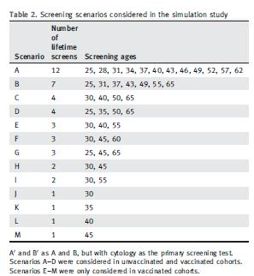
England
Screening scenarios considered:
Vaccination scenarios added to the model:
(1) 100% efficacy against HPV16/18
(ii) 15% cross-protection,
(iii) 22% cross-protection,
(iv) waning vaccine efficacy

Slide 16
English study findings
Women vaccinated with 9v vaccine: 2 lifetime screens
Unvaccinated women: 7 lifetime screens
HPV 16/18 vaccinated: 3 lifetime screens
Notes:
Since CERVIVA began in 2005, the consortium has conducted several studies on knowledge levels, attitudes and psychological aspects of cervical cancer screening and HPV infection.
In 2007, a large national GP survey was conducted to assess GP’s KNOWLEDGE, ATTITUDES AND PRACTICES in relation to cervical screening, HPV testing and HPV vaccination. This work was done my a previous CERVIVA reseracher, Dr Judith McRae. The survey revealed there were significant gaps in GP’s knowledge levels and on the back of these findings the ATHENS trial was founded and another previous CERVIVA reseracher Lisa McSherry conduced a qualitative interview study with GPs and PNs in 2011, followed by another national GP survey on knowledge, attitudes and views on cervical screening and HPV, only this time PNs were also survyed.
We have also conducted/Dr McRae a focus group study between 2007-2008 among women across Ireland to explore their knowledge of and attitudes towards cervical screening and HPV infection, testing and vaccination. This was followed by a large nationwide population survey on the same issues
We th
Lack of knowledge among women
Psych impact of HPV testing
Psych impact of colposcopy and treatment
Psychological impact of colposcopy and related procedures (before and during) is well documented
Accumulating evidence that colposcopy is associated with psychological after-effects
Need for better understanding about which women are at greatest risk of adverse psychological after-effects and how long these adverse outcomes persist*

Slide 17
English study findings
Fewer lifetime screens are necessary for vaccinated women to have the same level of protection against cervical cancer as is currently provided by 3- and 5-yearly cytology screening in unvaccinated women
Even in unvaccinated women, screening intervals can be safely lengthened with the introduction of HPV testing with cytology triage, compared to cytology testing
Until the level of herd immunity has been established to be safe to reduce the required frequency of cervical screening in unvaccinated women, vaccinated and unvaccinated women should have different screening algorithms
Importance of recording vaccination status, and linking this information to the screening programmes call–recall database

Slide 18
English study – strengths and limitations
Strengths:
Considered the nonavalent vaccine
Considered cross protection (HPV types not covered by vaccines)
Limitations:
not consider herd immunity, which would be expected to lower the incremental benefit of + screens in unvaccinated women
small range of possible screening scenarios
women who were fully vaccinated at age 12, prior to HPV exposure, or not vaccinated at all, not women who were partially vaccinated

Slide 19
Current situation in Ireland
The first cohort of schoolgirls vaccinated through this programme will be eligible for CervicalCheck in 2018-2019
By 2023, over 80%* of women aged 25 years entering CervicalCheck will be vaccinated against HPV 16 and HPV 18
If high vaccination rates can be maintained, consistent with international findings, a reduction in the prevalence of HPV 16 and 18 in unvaccinated women in Ireland is anticipated due to herd immunity
Vaccination uptake has declined in the last two years from 80 to apx 50%

Slide 20
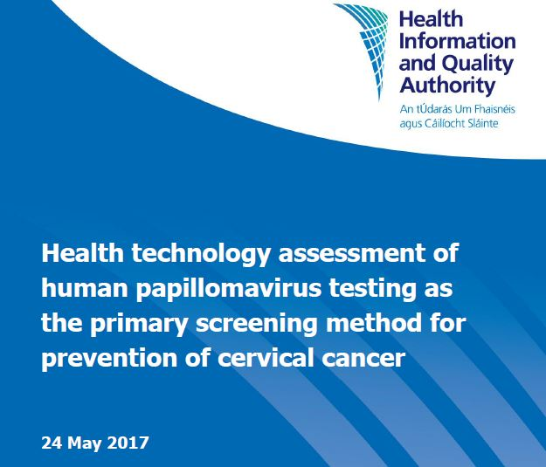
Ireland – Assessment of primary HPV screening
Considered a maximum screening interval of 5 years
All strategies considered for vaccinated and unvaccinated cohort
A policy of continued screening at five-yearly intervals may be reasonable until further long-term data emerge on the development of cervical cancer in these women
Subgroup analysis: (of women who only had access to organised screening from age 50 years) : extending screening exit age from 60 to 65 yrs provides a clinical benefit

Slide 21
Ireland – assessment of primary HPV screening
For a cohort of women not vaccinated against HPV 16 and 18:
primary HPV screening followed by liquid-based cytology (LBC) triage (that is LBC testing if the HPV test is positive) at five-yearly intervals from age 25 to 60 is cost-effective with an incremental cost-effectiveness ratio (ICER) of €29,788 per quality-adjusted life year (QALY)
For a cohort vaccinated against HPV 16 and HPV 18:
none of the strategies modelled in the HPV-vaccinated cohort are cost-effective
Given their lower risk of developing cervical cancer, less intensive screening strategies, which have not been modelled in this evaluation (which simulated screening intervals up to a maximum of five years), may be more appropriate for HPV-vaccinated women.
Ongoing high uptake(!) of an effective vaccine will lead to reduced disease prevalence, suggesting potential for a less intensive screening programme

Slide 22
Ireland - assessment of primary HPV screening HTA assessment
The majority of cervical cancers occur in women who do not participate in regular screening
Switching to primary HPV screening is not expected to lead to a substantial reduction in cervical cancer rates, unless participation in screening can be improved
There are limited data regarding screening participation of women who have been vaccinated against HPV 16 and HPV 18
Data provide conflicting evidence that attendance is higher and lower than for unvaccinated women

Slide 23
Ireland – proposed CervicalCheck approach
CervicalCheck current approach: 3 yrs for women aged 25-44; 5yrs for women aged 45-60
“Approach to vaccinated cohort will be the same as unvaccinated for the 1st 5 years at least….until the vaccinated at 12 years old cohort reaches 30 years
From a programmatic perspective it is difficult to discriminate between individuals - protocols will be based on percentage vaccinated and when within age cohorts.”
Clinical Director of CervicalCheck

Slide 24
Ireland –tailored future screening?
A screening programme tailored to an unvaccinated cohort may not be optimal for a vaccinated cohort
CervicalCheck uses a comprehensive linked screening registry and a call-recall based invitation system
Screening registry linked with the national HPV vaccination programme, with access to the HPV vaccination records of the women eligible for CervicalCheck. These mechanisms would allow CervicalCheck to develop a formal, ongoing evaluation process of HPV risk-based screening and would allow future screening to be tailored to the individual’s risk and screening history

Slide 25
The Netherlands –Herd immunity
Cost-effectiveness analysis
Vaccination against HPV reduces cervical cancer risk in unvaccinated women
Herd effect expected to increase over time
However, at a certain herd immunity level, tailoring screening to vaccination status may no longer be worth the additional effort
Aim: what level of herd immunity it is cost-effective to also reduce screening intensity in unvaccinated women

Slide 26
The Netherlands – herd immunity
Pre-vaccinated cohort
6 yrly primary screening (ages 30-72) most cost-effective
8 screens in a woman’s lifetime
Vaccinated cohort
Primary screening BUT with smaller age range (35-59 yrs) and longer screening intervals (12 years)
3 screens in woman’s lifetime
Herd immunity ‘level’
Different herd immunity levels assumed: 0%, 25%, 50%, 75%, 100%
Herd immunity of >=50% - screening intensity becomes cost-effective for unvaccinated women

Slide 27
The Netherlands – findings cont. and limitations
Screening should be optimized to vaccinated women as soon as unvaccinated women are substantially protected via herd immunity (>=50%)
decreasing the screening frequency of unvaccinated women
Ethical considerations of continuing with screening algorithms optimized to unvaccinated women instead of to those who adhered to vaccination
Women with abnormal cytology or HPV positive test results commonly experience fear, self-blame, distress and anxiety about cervical cancer
Limitations:
assumed that the efficacy of the vaccine has a lifelong duration – efficacy will wane??
assumed an equal background risk of cervical cancer for vaccinated and unvaccinated women – higher or lower?
effects of the nonavalent vaccine not modelled

Slide 28
Conclusions 1
Primary HPV screening for vaccinated and unvaccinated cohorts
Less intensive screening for vaccinated women – 2 or 3 lifetime screens?
Herd immunity will lead to a lower risk in unvaccinated women in the vaccination era than prior to vaccination, until the level of herd immunity has been established to be safe to reduce the required frequency of cervical screening, vaccinated and unvaccinated women should have different screening algorithms
A lot of uncertainties still remain:
Should screening be personalised based on vaccination status? Same screening pathway the same for unvaccinated and vaccinated women?

Slide 29
Conclusions 2
Tailoring screening to vaccination - resources for linked registries if tailoring a woman’s screening to her HPV vaccination status?
International practice in cervical screening and HPV vaccination varies considerably - Countries are likely to differ somewhat in their approaches to screening in vaccinated and unvaccinated women
If two separate screening strategies are needed and how these are implemented will not be uniform worldwide – many factors to consider depending on population/country

Slide 30
Limitations of current evidence
Studies are mathematical modelling/simulation studies
findings are sensitive to specific assumptions—e.g., unknown future adherence to screening, behaviours and test characteristics
Countries differ in their current cervical cancer screening protocols (age at commencement, intervals, etc)
Nonavalent and next generation vaccines
Optimal screening among women who have received HPV vaccination under ‘catch-up’ programmes
Lower SES countries where HPV vaccination has begun to take place but no organised screening – what screening algorithms are needed?
Implications for women:
Concerns of women who have worries over been screened less
HPV vaccinated women perceiving themselves as risk free and/or do not require cervical screening

Slide 31
Future directions
Linked screening-vaccination registries (some countries only!)
Registries of vaccinated and unvaccinated(!) women needed to inform screening based on woman’s individual history?
Future studies need to look at the effect of the nonavalent vaccine on screening requirements as the new generation vaccine will further reduce cervical cancer risk in the population
‘Safe’ herd immunity levels to reduce screening in unvaccinated women– more data needed
Continued monitoring of the increasing evidence on the long-term benefits of HPV vaccination will potentially allow for longer intervals between screening rounds
Actual cervical screening behaviours and influences of vaccinated and unvaccinated women needs to be monitored

Slide 32
Thank you
Further information: m.oconnor@ncri.ie
@MaireadOConnor8 & @Cerviva
www.cerviva.ie

